Slide 1
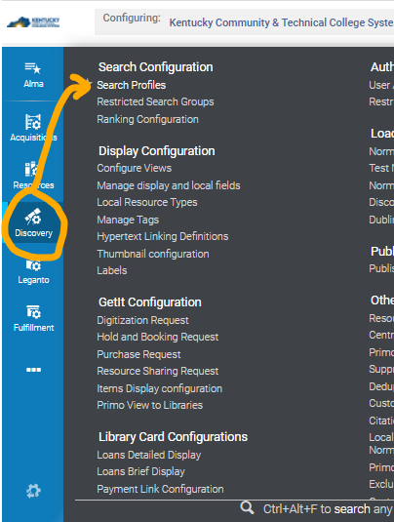
Step 1A: Define the Primo VE Webhook Search Scope.
Select Discovery -> Search Profiles

Slide 2
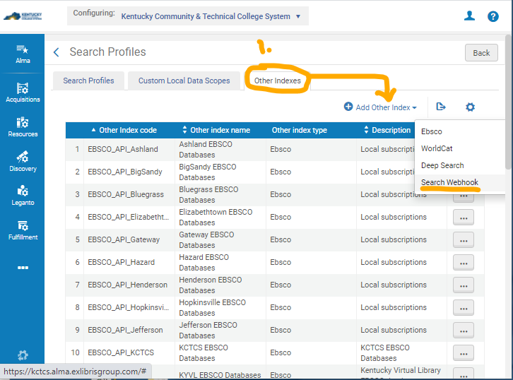
Step 1B: Click on Tab for Other Indexes, then +Add Other Indexes -> Search Webhook

Slide 3
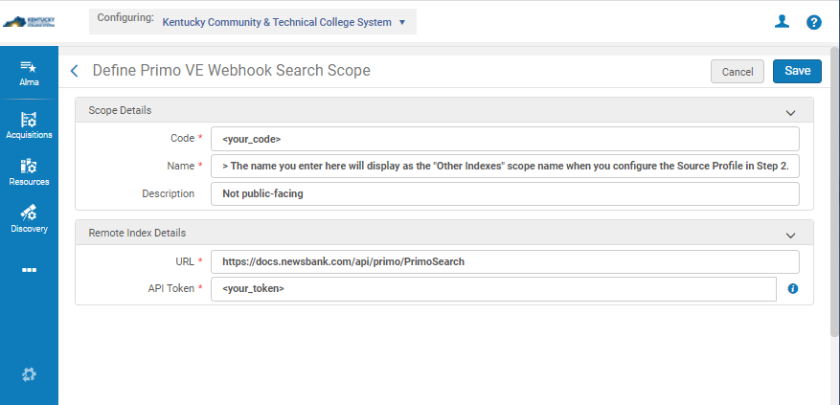
Step 1C: Code* and Name* are defined by institution/admin.
URL* is provided by NewsBank
API Token* is provided by NewsBank

Slide 4
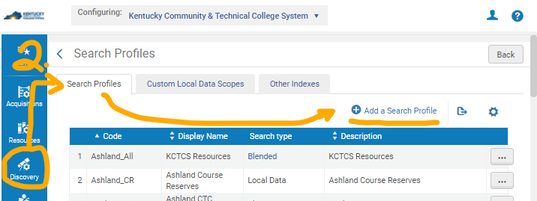
Step 2A: Define a Custom Search Profile.
Select Discovery -> Search Profiles -> +Add a Search Profile

Slide 5
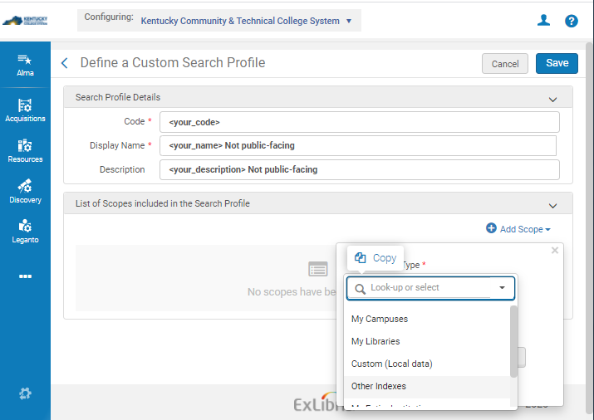
Step 2B: Code* and Display Name* are internal; Code is same as above.

Slide 6
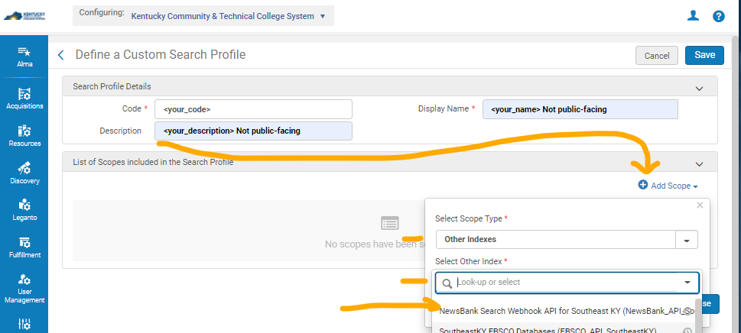
Step 2C: Click on +Add Scope -> Select Other Index* Internal name for NewsBank API should appear on list. Click on name.

Slide 7
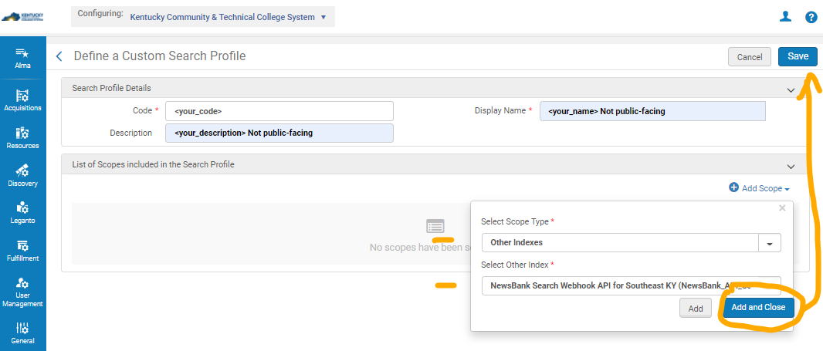
Step 2D: Click on Name, Click Add and Close, then Save.

Slide 8
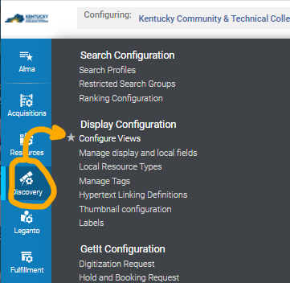
Step 3A: Adding to Search Scope. Select Discovery -> Configure Views

Slide 9
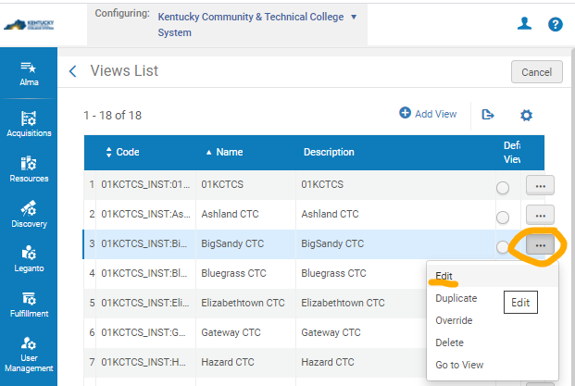
Step 3B: Choose location (campus or school) for installation of API. Click on …, Click Edit

Slide 10
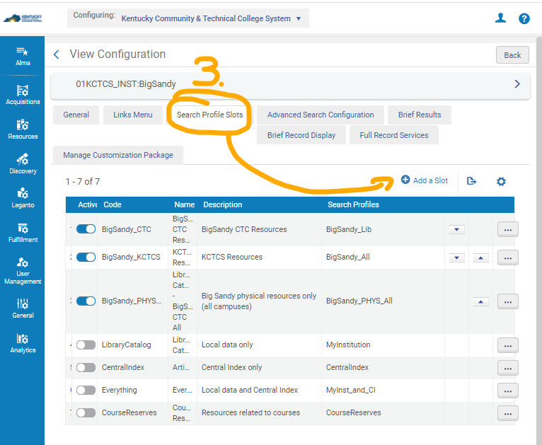
Step 3C: Select Tab for Search Profile Slots, then Click +Add a Slot

Slide 11
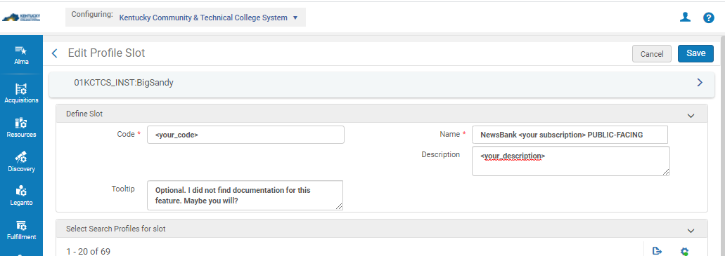
Step 3D: to Define the Slot,
Code* institution code defined in Step 1; Name* is public facing – name as database or “NewsBank.”

Slide 12
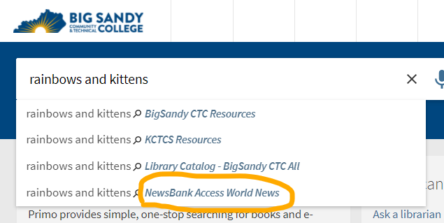
Next, check the Primo search scope listing.

Slide 13
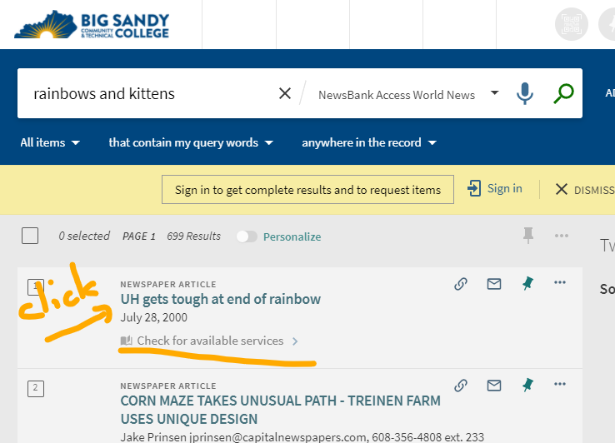
Search Results screen in Primo. Click on title of article.

Slide 14
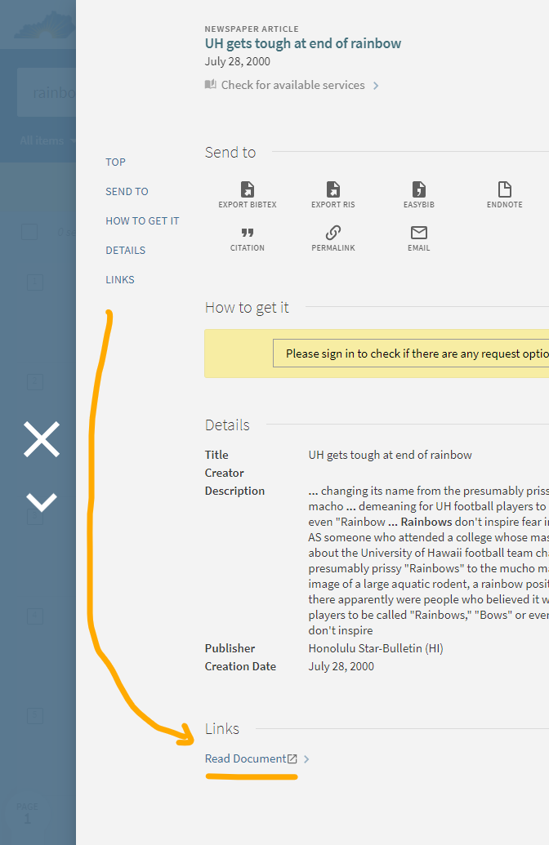
Article entry in Primo. To go to the full-text, please click on Read Document at the end of the entry. (perhaps some verbiage explaining why the feature to display full-text availability in yellow box is currently not working?)

Slide 15
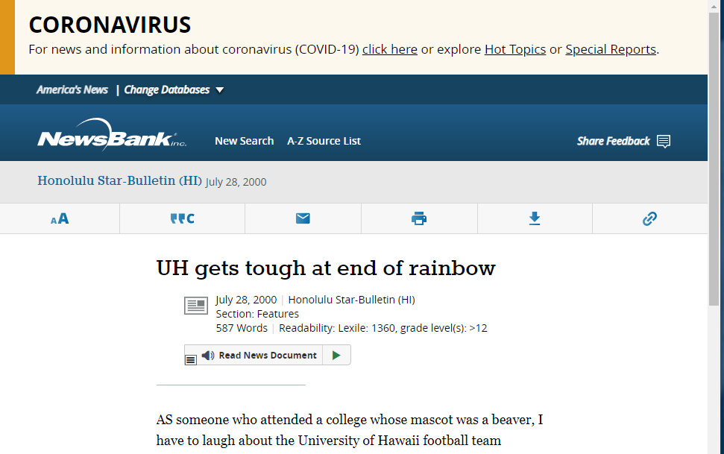
Article display in NewsBank. (Currently, users cannot continue their search in NewsBank without being prompted for the NewsBank username/password. The API Token does not seem to carry the authentication past the document retrieval.)

